Slide 1

SCHOOL OF COMPUTING
DEPARTMENT OF ARTIFICIAL INTELLIGENCE & MACHINE LEARNING
10214AM601/ MINOR PROJECT -1
SUMMER SEMESTER(2025-2026)
Semester End Project Examination Minor Project 1 – November 2025
SEMESTER END PROJECT VIVA VOCE EXAMINATIONS
“Stock Price Forecasting Using LSTM Neural Networks”
SUPERVISED BY
PRESENTED BY
Dr.D.Prabhu,M.E,MBA
1. B.V.AJITH KUMAR REDDY (VTU NO. 25453) (REG NO. 23UEAM0009)
2. K.BURHANULLA KHADRI (VTU NO. 26438) (REG NO. 23UEAM0029)
DEPARTMENT OF ARTIFICIAL INTELLIGENCE & MACHINE LEARNING / PROJECT TITLE

Slide 2
OVERVIEW
  ABSTRACT
  OBJECTIVE
  INTRODUCTION
  LITERATURE REVIEW (SOFT COPY OF PAPERS TO BE LINKED AS HYPERLINK)
  DESIGN AND METHODOLOGIES
  IMPLEMENTATION
  TESTING
  INPUT AND OUTPUT
  CONCLUSION
  FUTURE ENHANCEMENTS
  SOCIETAL IMPACT OF PROJECT
  WEB REFERENCES LINK (TILL REVIEW DATE ALL LINKS TO BE INCLUDED DAY WISE)
  PLAGIARISM REPORT OF PROJECT REPORT AND PPT
  JOURNAL/CONFERENCE PUBLICATION PROOF
  REFERENCES
DEPARTMENT OF ARTIFICIAL INTELLIGENCE & MACHINE LEARNING / PROJECT TITLE

Slide 3
  ABSTRACT
  Introduction:
  Stock prices are highly dynamic and influenced by various factors, making accurate prediction a challenging task.
  Purpose:
  To develop a deep learning model using Long Short-Term Memory (LSTM) networks for forecasting stock prices.
  Method:
  Historical stock market data is collected, preprocessed, and trained using LSTM neural networks to capture time-series dependencies.
  Result:
  The LSTM model shows better accuracy in predicting future stock trends compared to traditional methods.
  Conclusion:
  LSTM neural networks are effective for stock price forecasting and can support investors in making better financial decisions.
DEPARTMENT OF ARTIFICIAL INTELLIGENCE & MACHINE LEARNING / PROJECT TITLE

Slide 4
  OBJECTIVES
Aim of the Project:
The main aim is to design and implement a stock price prediction system using LSTM (Long Short-Term Memory) neural networks. The project seeks to capture the complex, non-linear, and time-dependent nature of stock market data to provide more accurate and reliable forecasts than traditional statistical models.
Scope of the Project:
The project covers the use of historical stock price data (open, close, high, low, and volume) for training the LSTM model.
It demonstrates the advantage of deep learning in financial time-series forecasting.
The scope includes analyzing trends, reducing prediction errors, and supporting better investment strategies.
The model can be expanded to predict multiple stocks simultaneously or applied to other financial instruments like indices, forex, or cryptocurrency.
It also provides a foundation for developing decision-support systems for traders, portfolio managers, and financial analysts.
DEPARTMENT OF ARTIFICIAL INTELLIGENCE & MACHINE LEARNING / PROJECT TITLE

Slide 5
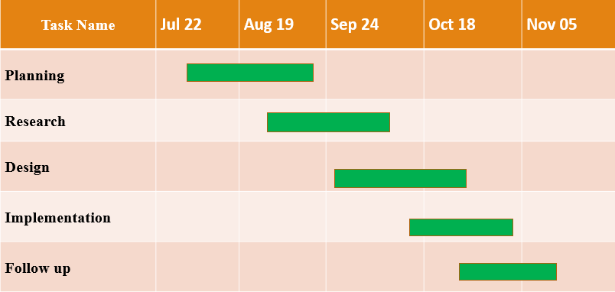
TIMELINE OF THE PROJECT
Gantt Chart
DEPARTMENT OF ARTIFICIAL INTELLIGENCE & MACHINE LEARNING / PROJECT TITLE

Slide 6
  INTRODUCTION
Stock market prediction has always been an area of interest for economists, investors, and researchers due to its potential impact on financial decision-making.
The unpredictable fluctuations in stock prices are influenced by multiple factors such as global events, company performance, market trends, and investor behavior.
Traditional forecasting methods (like ARIMA, linear regression) often fail to handle non-linear patterns and long-term dependencies in stock data.
Artificial Intelligence (AI) and Deep Learning have emerged as powerful tools for financial forecasting in the modern era.
Among these, LSTM neural networks, a type of recurrent neural network (RNN), are highly effective in modeling time-series data because they can remember long-term dependencies.
This project applies LSTM models to analyze past stock market data (open, close, high, low, and volume) and generate future predictions.
The outcomes of this project aim to help investors reduce risks, identify profitable opportunities, and make informed financial decisions.
Overall, the project bridges the gap between financial analysis and advanced deep learning techniques, showcasing how technology can transform investment strategies.
DEPARTMENT OF ARTIFICIAL INTELLIGENCE & MACHINE LEARNING / PROJECT TITLE

Slide 7
  LITERATURE REVIEW
Sl.No | Author’s Name | Paper name and publication details | Year of publication | Main content of the paper
1 | Fischer, T. & Krauss, C. | Deep Learning with Long Short-Term Memory Networks for Financial Market Predictions, European Journal of Operational Research. | 2018 | Demonstrated that LSTM models outperform traditional machine learning methods like Random Forest and SVM in forecasting stock market trends.
2 | Rather, A. M., Agarwal, A., & Sastry, V. N. | Recurrent Neural Network and LSTM Based Approach for Stock Market Prediction, Elsevier. | 2021 | Proposed a hybrid RNN-LSTM model that effectively captures long-term dependencies in stock data for accurate predictions.
DEPARTMENT OF ARTIFICIAL INTELLIGENCE & MACHINE LEARNING / PROJECT TITLE

Slide 8
3 | Gülmez, B. | Stock Price Prediction with Optimized Deep LSTM (LSTM-ARO), Journal of Intelligent Systems. | 2023 | Introduced an optimization-based deep LSTM model using Adaptive Random Optimization to enhance accuracy and reduce computation time.
4 | Vuong, P. H., et al. | A Bibliometric Literature Review of Stock Price Forecasting, IEEE Access. | 2024 | Conducted a large-scale review comparing ML and DL models, concluding that LSTM and hybrid approaches show superior forecasting performance.
5 | Nelson, D. M., Pereira, A. C. M., & de Oliveira, R. A. | Stock Market’s Price Movement Prediction with LSTM Neural Networks, IEEE International Conference on Computational Intelligence. | 2017 | Applied LSTM models to stock index prediction and achieved higher directional accuracy than traditional statistical methods.
DEPARTMENT OF ARTIFICIAL INTELLIGENCE & MACHINE LEARNING / PROJECT TITLE

Slide 9
6 | Kumar, R., & Gopal, M | Forecasting Stock Market Trends Using Hybrid LSTM and GRU Models, Springer Nature. | 2020 | Combined LSTM and GRU layers to create a hybrid architecture that improved model stability and accuracy on NSE datasets.
7 | Zhang, Z., & Lee, C. | Hybrid CNN-LSTM Model for Stock Price Prediction, Journal of Big Data. | 2022 | Proposed a CNN-LSTM hybrid model for feature extraction and temporal learning, achieving reduced RMSE on multiple stock datasets.
8 | Wang, J., & Kim, T. | Enhancing Stock Price Prediction Using Attention-Based LSTM Networks, IEEE Transactions on Neural Networks. | 2025 | Integrated attention mechanisms into LSTM to focus on important time steps, improving model interpretability and forecasting precision.---Would you like me to make a short paragraph summary after this table (to include in your project report before “Conclusion”)? It would explain how these papers influenced your work.
DEPARTMENT OF ARTIFICIAL INTELLIGENCE & MACHINE LEARNING / PROJECT TITLE

Slide 10
  DESIGN AND METHODOLOGIES
Module 1: Data Collection
Gather historical stock data (Open, High, Low, Close, Volume) from Yahoo Finance / Quandl.
Module 2: Data Preprocessing
Clean missing values, normalize features, and create time-series sequences.
Split into training and testing datasets.
Module 3: Model Design (LSTM Network)
Construct LSTM architecture with input, hidden (LSTM layers), and output layers.
Use activation functions (ReLU/Tanh in hidden, Linear in output).
Module 4: Model Training
Train model with Adam optimizer and Mean Squared Error (MSE) as loss function.
DEPARTMENT OF ARTIFICIAL INTELLIGENCE & MACHINE LEARNING / PROJECT TITLE

Slide 11
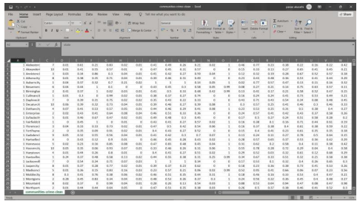
MODULE 1: Data Collection
Step:1 Collection of data
DEPARTMENT OF ARTIFICIAL INTELLIGENCE & MACHINE LEARNING / PROJECT TITLE

Slide 12
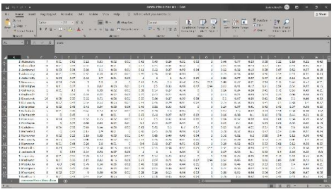
Step 2: Processing the data
.
DEPARTMENT OF ARTIFICIAL INTELLIGENCE & MACHINE LEARNING / PROJECT TITLE

Slide 13
Module 2- Data Preprocessing
LSTM (Long Short-Term Memory) is a type of Recurrent Neural Network (RNN) that is effective for time series prediction.
LSTM can learn long-term dependencies in sequential data, making it suitable for stock price forecasting.
Data Preprocessing Steps:
1. Data Collection:
Collect historical stock price data (e.g., Open, High, Low, Close, Volume) from sources like Yahoo Finance.
2. Data Cleaning:
Handle missing values by imputation or removal.
Remove outliers that can distort predictions.
3. Feature Selection:
Select relevant features such as closing price, moving averages, or technical indicators.
DEPARTMENT OF ARTIFICIAL INTELLIGENCE & MACHINE LEARNING / PROJECT TITLE

Slide 14
4. Normalization/Scaling:
Scale features using Min-Max Scaler (0-1 range) to improve LSTM performance.
5. Train-Test Split:
Split the dataset into training and testing sets (commonly 80:20 ratio).
6. Sequence Creation:
Convert time series data into sequences (sliding window) to feed into LSTM.
Example: Using the last 60 days of data to predict the next day’s stock price.
DEPARTMENT OF ARTIFICIAL INTELLIGENCE & MACHINE LEARNING / PROJECT TITLE

Slide 15
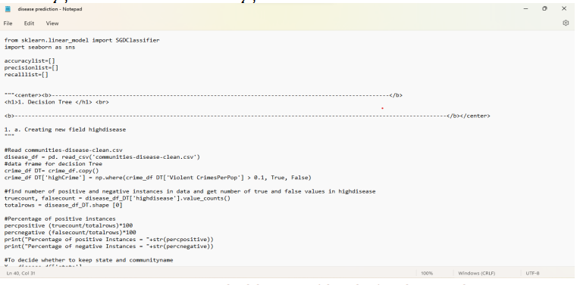
Step 3: Using algorithm’s
DEPARTMENT OF ARTIFICIAL INTELLIGENCE & MACHINE LEARNING / PROJECT TITLE

Slide 16
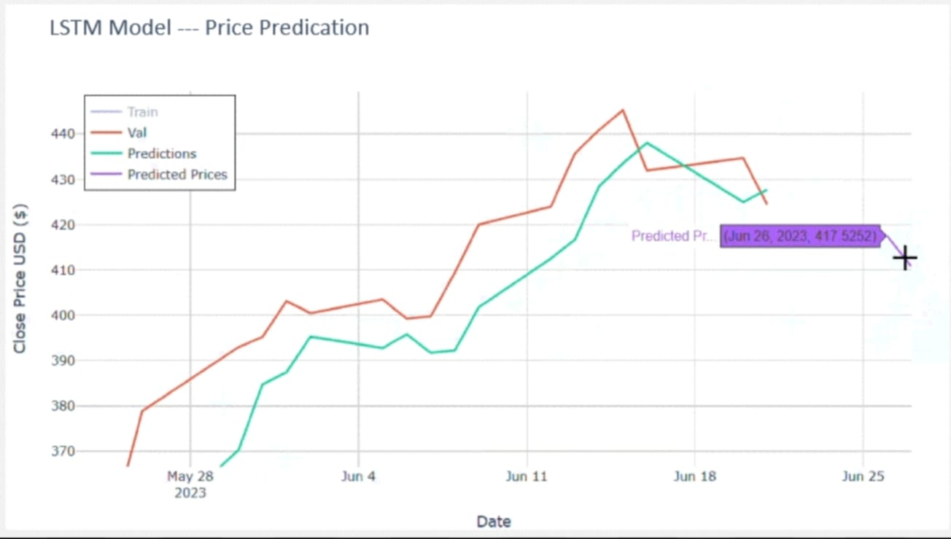
Step 4: The output
DEPARTMENT OF ARTIFICIAL INTELLIGENCE & MACHINE LEARNING / PROJECT TITLE

Slide 17
IMPLEMENTATION
Architecture Diagram
Data –Flow Diagram
Use Case Diagram
Class Diagram
Activity Diagram
Sequence Diagram
Collaboration Diagram(If applicable)
E-R Diagram
DEPARTMENT OF ARTIFICIAL INTELLIGENCE & MACHINE LEARNING / PROJECT TITLE

Slide 18
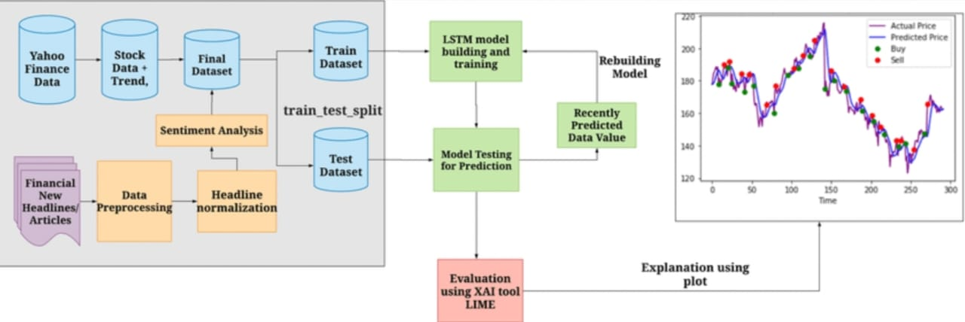
Architecture Diagram
Input data consists of historical stock prices and additional relevant features such as volume, technical indicators, etc.
Data preprocessing includes scaling/normalization and selection of important features for better model performance.
The LSTM model processes sequential stock data, capturing temporal dependencies and patterns.
LSTM layers have memory cells to retain information over time, suited for time series forecasting.
Dropout layers help prevent overfitting by randomly disabling some neurons during training.
A dense layer follows the LSTM to map learned features to the output prediction.
The final output layer produces the predicted next-day stock price or prices for a forecast horizon.
Model training involves minimizing the error between predicted and actual stock prices using historical data.
DEPARTMENT OF ARTIFICIAL INTELLIGENCE & MACHINE LEARNING / PROJECT TITLE

Slide 19
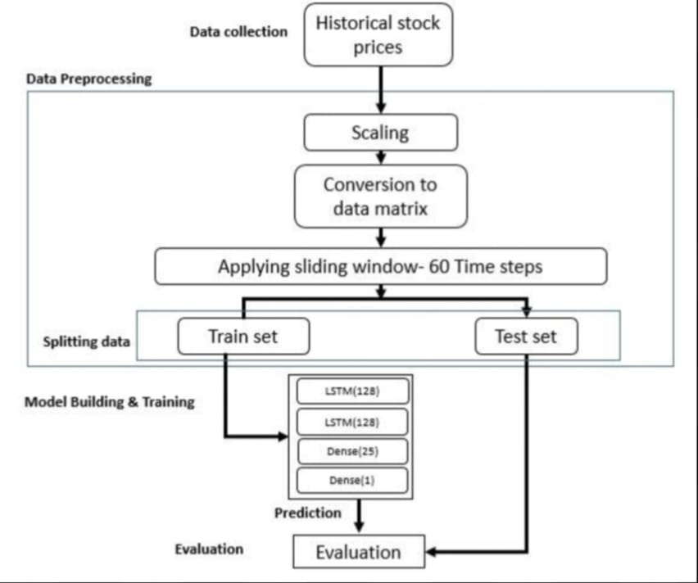
Data –Flow Diagram
DEPARTMENT OF ARTIFICIAL INTELLIGENCE & MACHINE LEARNING / PROJECT TITLE

Slide 20
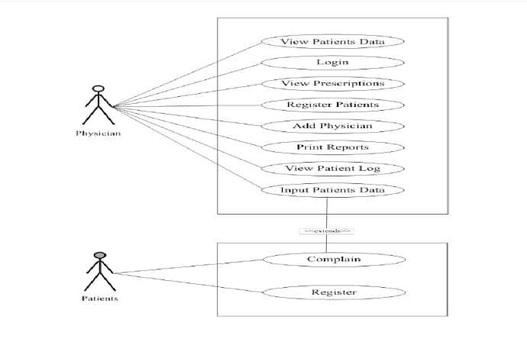
Use Case Diagram
Eg,
DEPARTMENT OF ARTIFICIAL INTELLIGENCE & MACHINE LEARNING / PROJECT TITLE

Slide 21
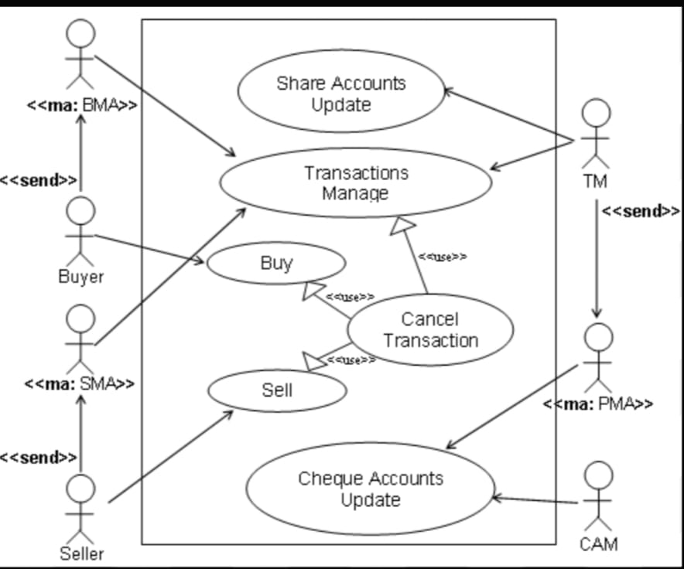
Use Case Diagram
DEPARTMENT OF ARTIFICIAL INTELLIGENCE & MACHINE LEARNING / PROJECT TITLE

Slide 22
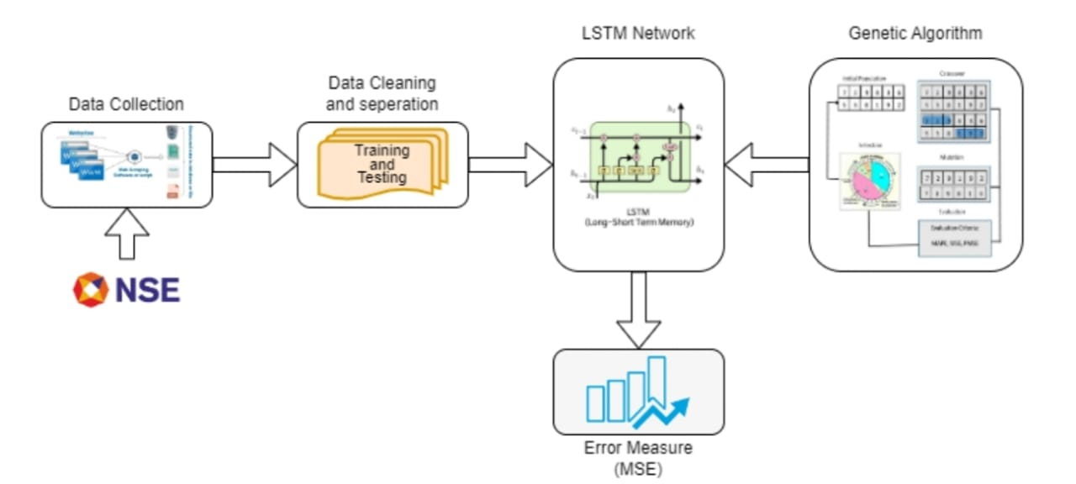
Class Diagram
DEPARTMENT OF ARTIFICIAL INTELLIGENCE & MACHINE LEARNING / PROJECT TITLE

Slide 23
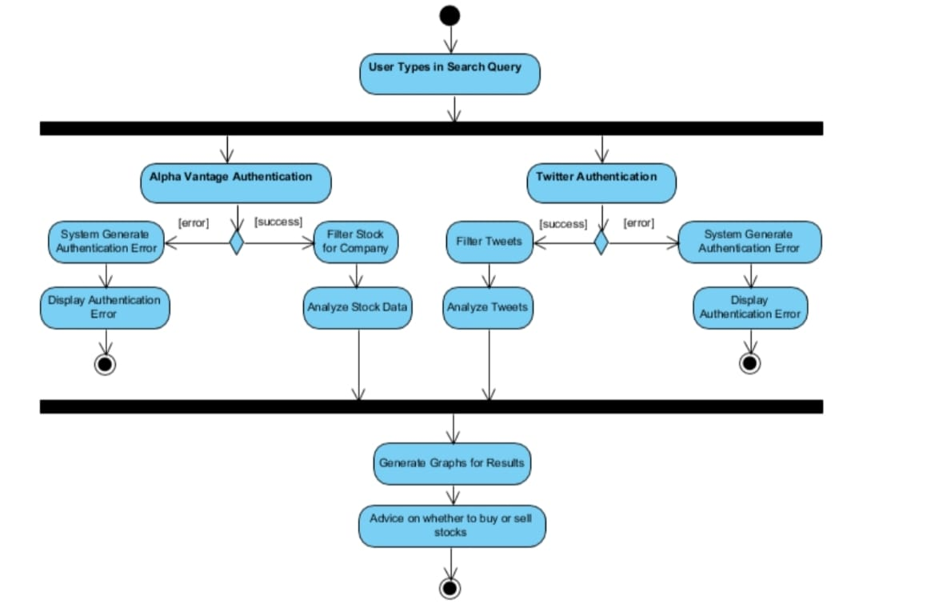
Activity Diagram
DEPARTMENT OF ARTIFICIAL INTELLIGENCE & MACHINE LEARNING / PROJECT TITLE

Slide 24
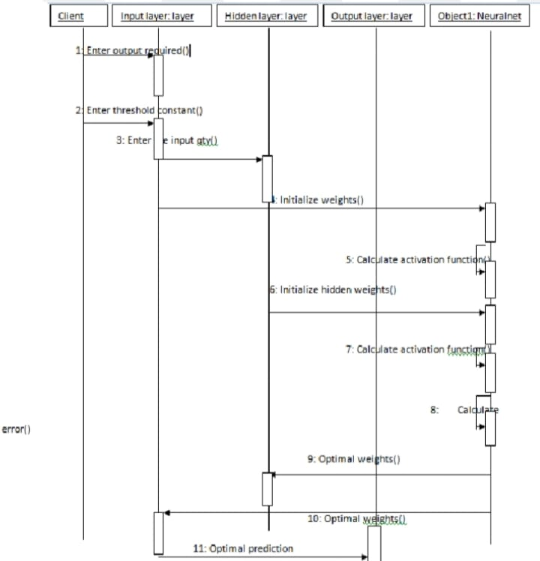
Sequence Diagram
DEPARTMENT OF ARTIFICIAL INTELLIGENCE & MACHINE LEARNING / PROJECT TITLE

Slide 25
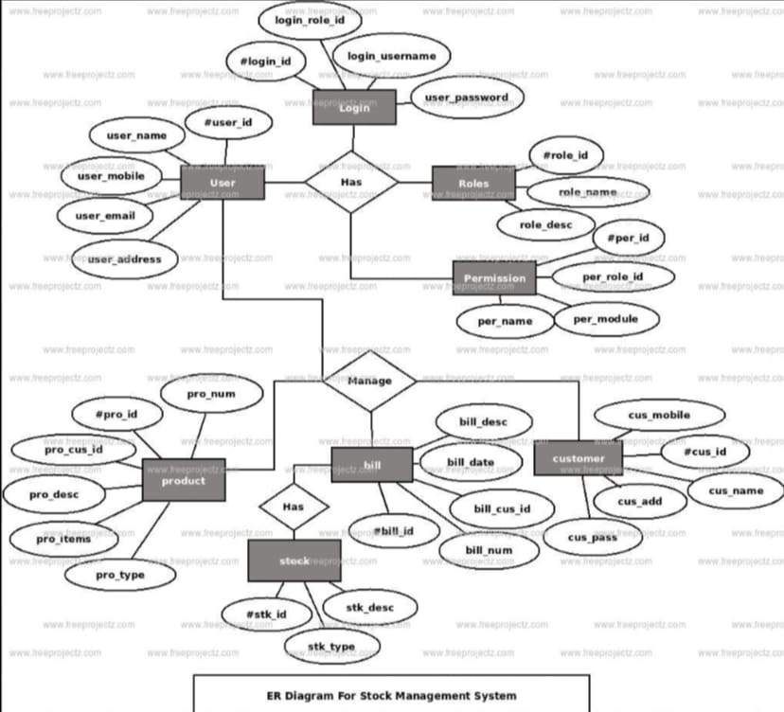
E-R Diagram
DEPARTMENT OF ARTIFICIAL INTELLIGENCE & MACHINE LEARNING / PROJECT TITLE

Slide 26
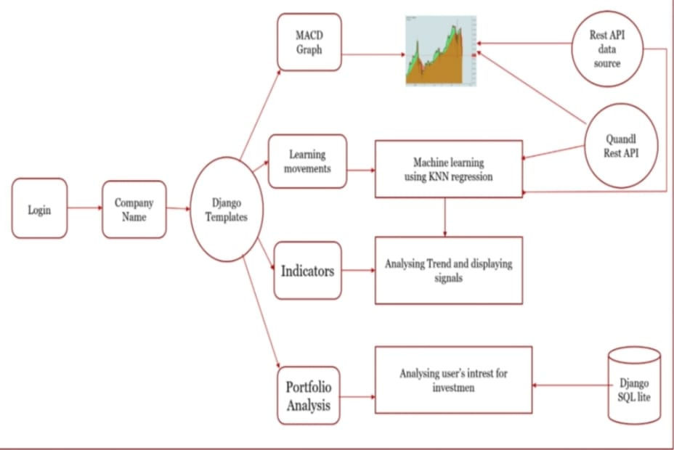
Collaboration Diagram(If applicable)
DEPARTMENT OF ARTIFICIAL INTELLIGENCE & MACHINE LEARNING / PROJECT TITLE

Slide 27
TESTING
  UNIT TESTING
  INTEGRATION TESTING
  FUNCTIONAL TESTING
  WHITE BOX TESTING
  BLACK BOX TESTING
DEPARTMENT OF ARTIFICIAL INTELLIGENCE & MACHINE LEARNING / PROJECT TITLE

Slide 28
  UNIT TESTING
Unit testing is an essential part of the development process that ensures each module of the stock price forecasting system functions correctly before the entire model is integrated. In this project, unit testing was applied to various components such as data preprocessing, model construction, training, prediction, and evaluation. The main goal of unit testing is to verify that each part of the system performs as expected under different conditions. The testing process was carried out using the Python unittest framework along with libraries such as TensorFlow, NumPy, and Pandas.
During testing, the preprocessing module was verified to ensure proper handling of missing values, normalization, and data splitting. The LSTM model construction was tested to confirm the correct number of layers, neuron configurations, and input-output shapes. The prediction module was checked to validate that the model produced accurate outputs with the expected dimensions and without missing or NaN values. Similarly, the evaluation module was tested to confirm the correct calculation of performance metrics such as Mean Squared Error (MSE) and Root Mean Squared Error (RMSE).
  INTEGRATION TESTING
Integration testing is performed after unit testing to ensure that all the individual modules of the stock price forecasting system work together as a complete and cohesive unit. In this project, integration testing was carried out to verify the interaction between various components such as data preprocessing, LSTM model training, prediction, and evaluation modules. While unit testing ensures that each module performs correctly in isolation, integration testing focuses on the proper data flow and functional coordination among these modules when combined.
The testing process began by integrating the data preprocessing module with the model construction and training module, ensuring that the normalized and reshaped datasets were correctly passed to the LSTM model. Next, the prediction module was tested along with the evaluation module to confirm that the model-generated predictions were properly utilized for performance measurement using metrics such as MSE and RMSE.
DEPARTMENT OF ARTIFICIAL INTELLIGENCE & MACHINE LEARNING / PROJECT TITLE

Slide 29
SYSTEM TESTING
System testing is the final phase of the testing process in which the complete and fully integrated stock price forecasting system is tested as a whole. The main objective of system testing is to validate that the developed system meets all specified requirements and performs efficiently under realistic conditions. In this project, system testing was conducted after successful completion of unit and integration testing to ensure that the LSTM-based forecasting model, along with all supporting modules, works together correctly from end to end.
The testing process involved verifying the overall workflow, starting from data collection and preprocessing to LSTM model training, prediction, evaluation, and visualization. Real-world stock market datasets were used to simulate actual user scenarios and to check how the system handles large volumes of data, missing values, and unexpected fluctuations in price trends. The system was tested for accuracy, robustness, usability, and consistency of predictions. Key performance metrics such as Mean Squared Error (MSE) and Root Mean Squared Error (RMSE) were computed to assess the prediction quality.
FUNCTIONAL TESTING
Functional testing focuses on verifying that each feature of the stock price forecasting system operates in accordance with the specified requirements and delivers the expected outcomes. In this project, functional testing was performed to ensure that all functions — such as data loading, preprocessing, model training, prediction, and visualization — work correctly and produce accurate results when given valid input data. Unlike unit testing, which examines individual components, functional testing validates the system’s behavior from a user’s perspective, ensuring that every function produces the desired output for real-world stock data.
The testing began with verifying the data preprocessing functions, ensuring that missing values were handled correctly, data was normalized, and the dataset was properly split into training and testing sets. The model training function was tested to confirm that the LSTM neural network was successfully compiled, trained without errors, and produced decreasing loss values during epochs. The prediction module was tested to check that it generated future stock price forecasts accurately and consistently, while the evaluation module was validated to confirm the correct computation of metrics such as Mean Squared Error (MSE) and Root Mean Squared Error (RMSE). Additionally, the visualization function was verified to ensure that the actual and predicted price graphs were plotted correctly for better understanding and analysis.
DEPARTMENT OF ARTIFICIAL INTELLIGENCE & MACHINE LEARNING / PROJECT TITLE

Slide 30
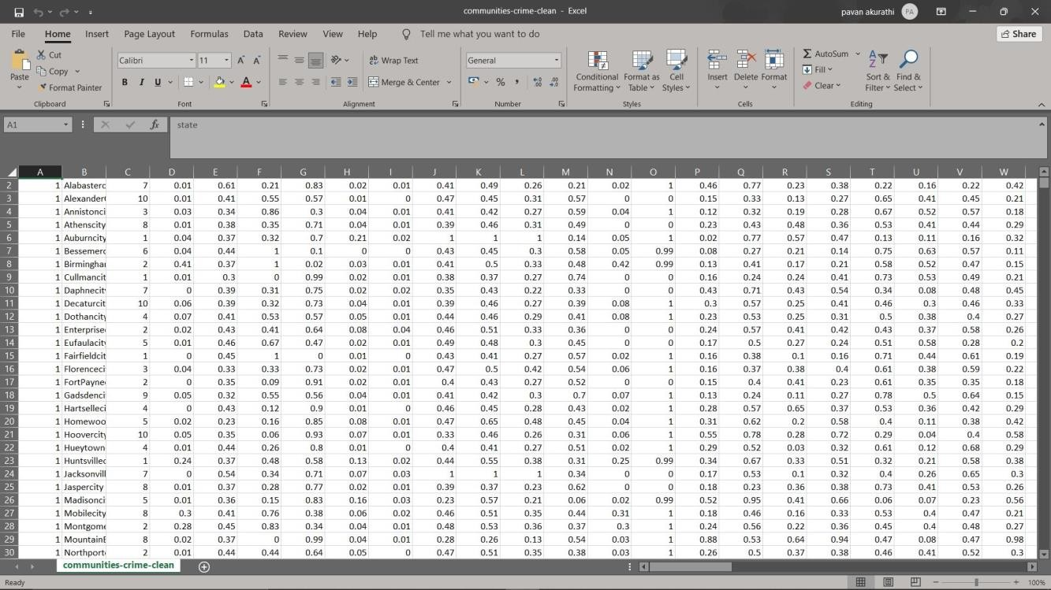
INPUT AND OUTPUT
DEPARTMENT OF ARTIFICIAL INTELLIGENCE & MACHINE LEARNING / PROJECT TITLE

Slide 31
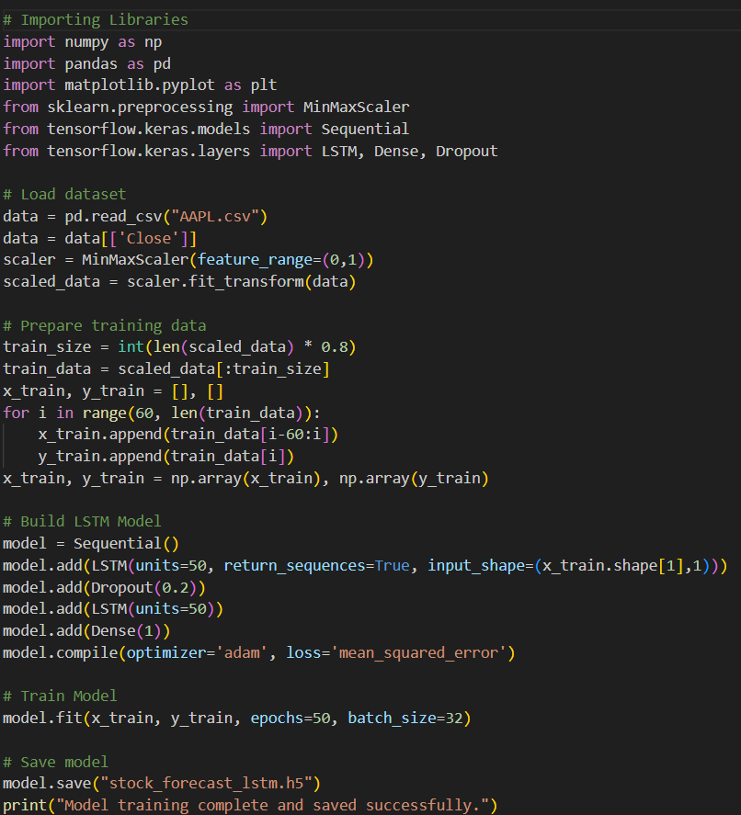
SOURCE CODE
DEPARTMENT OF ARTIFICIAL INTELLIGENCE & MACHINE LEARNING / PROJECT TITLE

Slide 32
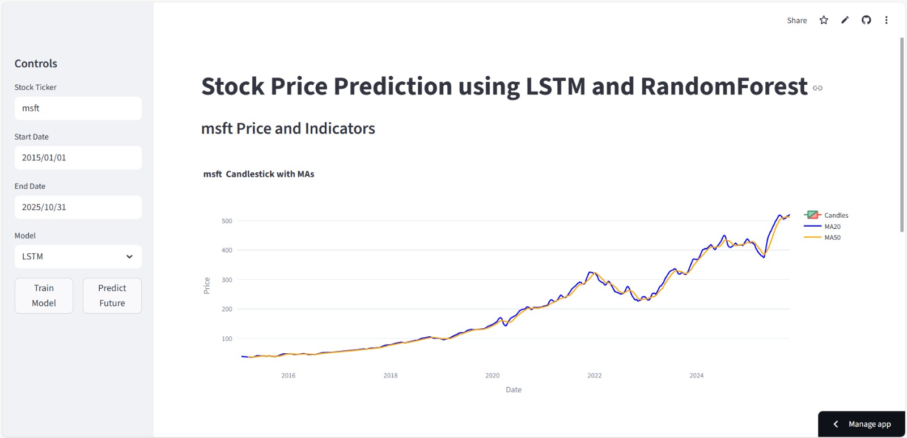
OUTPUT
DEPARTMENT OF ARTIFICIAL INTELLIGENCE & MACHINE LEARNING / PROJECT TITLE

Slide 33
CONCLUSION
AIM
To develop a stock price forecasting system using LSTM Neural Networks.
To analyze historical stock market data and predict future price trends.
To utilize deep learning techniques for capturing complex time-series dependencies.
To assist investors and analysts in making data-driven financial decisions.
PROBLEM STATEMENT
Stock market prices are highly volatile and influenced by numerous unpredictable factors.
Traditional models (like linear regression and ARIMA) struggle to capture nonlinear relationships in financial data.
There is a need for a robust forecasting model that can learn and remember long-term dependencies in sequential data.
The challenge lies in designing a deep learning-based approach that can accurately predict future stock prices using past data.
This project addresses the issue by implementing an LSTM Neural Network for effective and accurate stock price forecasting.
DEPARTMENT OF ARTIFICIAL INTELLIGENCE & MACHINE LEARNING / PROJECT TITLE

Slide 34
  FUTURE ENHANCEMENTS
Incorporating More Features
Technical Indicators:
Include moving averages, RSI, MACD, Bollinger Bands, etc., to provide richer inputs.
Fundamental Data:
Incorporate earnings reports, P/E ratios, or economic indicators.
Sentiment Analysis:
Use news headlines, social media sentiment, or financial reports to capture market sentiment.
2. Model Architecture Improvements
Stacked LSTM / Bi-directional LSTM:
Capture more complex temporal patterns.
Attention Mechanisms:
Allow the model to focus on important time steps.
Hybrid Models:
Combine LSTM with CNNs or Transformers to capture both temporal and feature patterns.
DEPARTMENT OF ARTIFICIAL INTELLIGENCE & MACHINE LEARNING / PROJECT TITLE

Slide 35
  SOCIETAL IMPACT OF PROJECT
1.Enhanced Financial Decision-Making
By providing more accurate forecasts of stock prices, investors—both individual and institutional—can make better-informed decisions.
This can lead to improved portfolio management, reduced financial risks, and more efficient capital allocation.
2.Promotion of Financial Literacy
Exposure to predictive modeling and AI-driven analysis encourages individuals to understand stock market dynamics.
Users can learn how data-driven approaches influence investment strategies, fostering a culture of analytical thinking in finance.
3.Economic Efficiency
Accurate stock forecasting can reduce market volatility caused by uninformed trading decisions.
This helps in stabilizing markets, which has a broader impact on national and global economies.
4.Job Creation and Technological Advancements
Development and deployment of AI-driven forecasting systems create opportunities for data scientists, AI engineers, and financial analysts.
It also stimulates innovation in financial technology (FinTech), encouraging growth in related sectors.
DEPARTMENT OF ARTIFICIAL INTELLIGENCE & MACHINE LEARNING / PROJECT TITLE

Slide 36
Web references/video links
Deep Learning‑Based Stock Price Prediction Using LSTM Model. Available at: https://www.bbwpublisher.com/index.php/PBES/article/view/8611 BBWPublisher
Stock Price Prediction Using Deep Learning (LSTM) with a Recursive Approach. Available at: https://jurnal.polibatam.ac.id/index.php/JAIC/article/view/10514 Jurnal Politeknik Negeri Batam
Stock Price prediction with LSTM Based Deep Learning Techniques. Available at: https://www.ijasi.org/index.php/ijasi/article/view/47 ijasi.org
Estimation of Stock Price Using LSTM Algorithm and Sentiment Analysis. Available at: https://www.rgnpublications.com/journals/index.php/cma/article/view/2595 rgnpublications.com
Stock Market Prediction using LSTM. Available at: https://eudl.eu/doi/10.4108/eai.27-2-2020.2303545 EUDL
Stock Price Prediction using LSTM Model. Available at: https://drpress.org/ojs/index.php/HSET/article/view/7352 Darcy & Roy Press
Stock Price Prediction using ML and LSTM based Deep Learning models. Available at: https://jieee.a2zjournals.com/index.php/ieee/article/view/37 jieee.a2zjournals.com
A Study on Stock Price Prediction Based on Associated Network Model of LSTM. Available at: https://link.springer.com/article/10.1007/s13042-019-01041-1 SpringerLink
The Stock Price Forecasting Based on Time Series Model and Neural Network. Available at: https://bcpublication.org/index.php/BM/article/view/4319 bcpublication.org
A Survey on LSTM‑based Stock Market Prediction. Available at: https://ilkogretim-online.org/index.php/pub/article/view/5251 ilkogretim-online.org
DEPARTMENT OF ARTIFICIAL INTELLIGENCE & MACHINE LEARNING / PROJECT TITLE

Slide 37
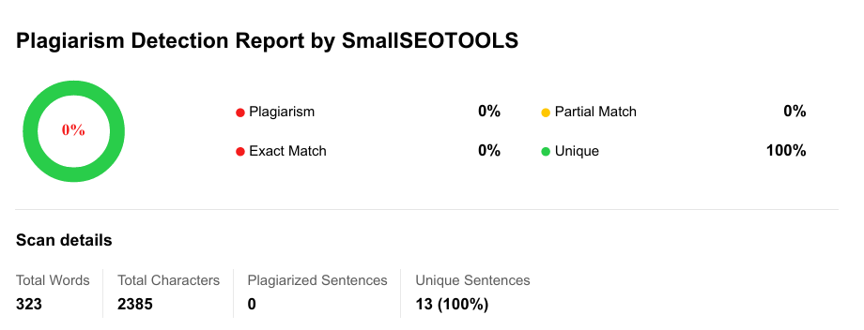
Plagiarism Report of PPT
DEPARTMENT OF ARTIFICIAL INTELLIGENCE & MACHINE LEARNING / PROJECT TITLE

Slide 38
  JOURNAL/CONFERENCE PUBLICATION PROOF
M. S. Zakka & E. Emigawaty, “Stock Price Prediction Using Deep Learning (LSTM) with a Recursive Approach”, Journal of Applied Informatics and Computing (JAIC), Vol 9, No 5, pp 2468‑2477, October 2025. DOI: 10.30871/jaic.v9i5.10514. Jurnal Politeknik Negeri Batam
F. Ahmad & P. Singh, “Stock Price Prediction using ML and LSTM based Deep Learning models”, Journal of Informatics Electrical and Electronics Engineering (JIEEE), Vol 3, No 1, pp 1‑13, April 2022. DOI: 10.54060/JIEEE/003.01.008. jieee.a2zjournals.com
S. Sathish & G. M. Kiran, “Stock Price prediction with LSTM Based Deep Learning Techniques”, International Journal of Advanced Scientific Innovation, Vol 2, No 3, pp 18‑21, August 2021. DOI: 10.5281/zenodo.5327647. ijasi.org
Junrong Nie, “Research on Stock Price Prediction Model Based on LSTM”, Highlights in Science, Engineering and Technology (HSET). DOI:10.54097/56k4q130. Darcy & Roy Press
Changquan Gu, “Research on Stock Market Index Prediction Based on LSTM Model”, BCP Business & Management, Vol 48, DOI:10.54691/bcpbm.v48i.5357. Boya Century Publishing
Jaya Bharathi M & Ilavarasan S, “Unlocking Market Trends: LSTM‑based Stock Price Forecasting for Intelligent Investments”, Advancements in Communication and Systems, ISBN 978‑81‑955020‑7‑3, DOI:10.56155/978‑81‑955020‑7‑3‑55, Sep 2024. publications.scrs.in
“Stock Market Prediction using LSTM”, Priya Sidhu, Himanshu Aggarwal & Madan Lal, Proceedings of the 2nd International Conference on ICT for Digital, Smart, and Sustainable Development (ICIDSSD 2020), Jamia Hamdard, New Delhi, India. DOI:10.4108/eai.27‑2‑2020.2303545. EUDL
Yifan Zhang, “Stock Price Prediction Using ARIMA and LSTM Models: An Application to CSI 300 Closing Prices”, Highlights in Science, Engineering and Technology (HSET). DOI:10.54097/7dgx1c14.
DEPARTMENT OF ARTIFICIAL INTELLIGENCE & MACHINE LEARNING / PROJECT TITLE

Slide 39
REFERENCES
Mehtab, S., Sen, J. (2020). A Time Series Analysis-Based Stock PricePrediction Using Machine Learning and Deep Learning Models. arXiv.
Li, Y., Pan, Y. (2020). A Novel Ensemble Deep Learning Model for StockPrediction Based on Stock Prices and News. arXiv.
Sidhu, P., Aggarwal, H., Lal, M. (2021). Stock Market Prediction usingLSTM. In Proceedings of ICIDSSD 2020.
Sathish, S., Kiran, G. M. (2021). Stock Price Prediction with LSTM BasedDeep Learning Techniques. International Journal of Advanced ScientificInnovation.
Saracık, ¨O., ˙Incekırık, A. (2023). Stock Price Forecasting with DeepLearning Techniques. Alphanumeric.
Rizky Naufal, G., Wibowo, A. (2023). Time Series Forecasting Based onDeep Learning CNN-LSTM-GRU Model on Stock Prices. IJETT Journal,71(6).
Zh¯ang, B. (2023). The Stock Price Forecasting Based on Time Series Modeland Neural Network. BCP Business Management.
Wang, Z. (2024). Stock Price Prediction using LSTM Neural Networks:Techniques and Applications. Applied and Computational Engineering.
Jaya Bharathi, M., Ilavarasan, S. (2024). Unlocking Market Trends:LSTM-based Stock Price Forecasting for Intelligent Investments. Advancesin Communication and Systems.36
You, Y. (2025). Forecasting Stock Price: A Deep Learning Approachwith LSTM And Hyperparameter Optimization. Highlights in Science,Engineering and Technology
DEPARTMENT OF ARTIFICIAL INTELLIGENCE & MACHINE LEARNING / PROJECT TITLE

Slide 40

DEPARTMENT OF ARTIFICIAL INTELLIGENCE & MACHINE LEARNING / PROJECT TITLE

